Slide 1
Catering Idea Guide
Becky Coates
bcoates@mmihg.com
662-685-4771 ext 140

Slide 2
Thank You…
for choosing MMI Catering
We understand the importance of catering on your campus as well as in the community. We are accustomed to planning and executing upscale events. We are ready to provide you with exceptional quality, service and upscale presentation. Our unrivaled experience, professionalism and food quality helps our team produce many incredibly successful events each year. With beautifully prepared and delicious food, outstanding design, and a courteous staff that prides itself on excellence, we’ll make your guests feel special, allowing you to focus solely on the mission of your event.
Any budget - Any style – From 10 guests to 5,000+ - We’ll make it happen! From start to finish, MMI will take care of every last detail. We will offer a broad range of catering menus and event services. Our culinary team will welcome events that require custom menus and special requests. We look forward to catering your next event!

Slide 3
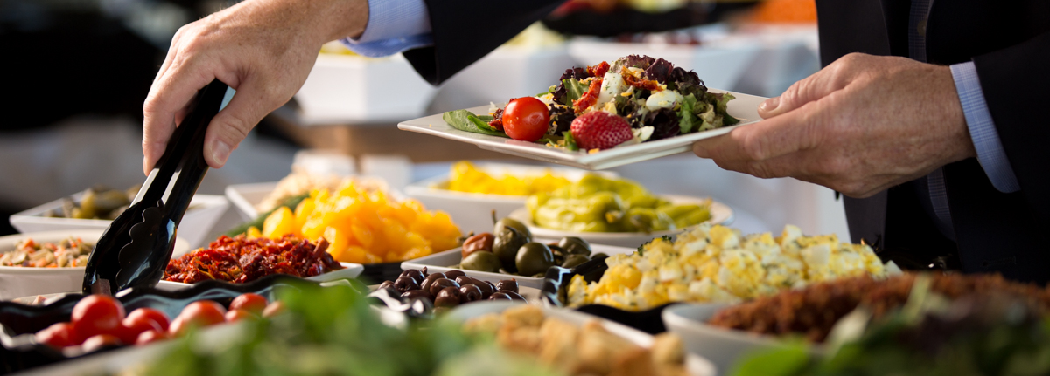
Levels of Service
Drop Off / Pickup Service
This service includes delivery with upscale disposable service ware. No linen, service staff or cleanup.
Basic Service
This service includes delivery and setup of your event with buffet linen, upscale disposable service ware and pickup following event. Guest table linen and service staff is not included in basic service.
Full Service
This service includes setup, service during and cleanup of your event. Basic guest table linens, china, glass & silverware is included.
Pricing noted on following pages College $ | Outside Groups $$
Outside groups will also be subject to a 15% service charge on all events.
Delivery & Setup
Food and beverages are delivered and set up with appropriate service ware at least 30 minutes prior to the start of your event. All items will be unpacked and set-up to create a visually appealing display.
To ensure the best possible service, our catering manager is available to assist you with the details of your event.
We suggest that you contact the catering office four to six weeks prior to your event to make arrangements.
What we need to know:
Date Number of guests Location Time Type of event
Guarantees
The guarantee is required 72 hours or 3 business days prior to your event. This number represents the minimum number of guests for which you will be charged. Number of guests may be increased until 24 hours or 1 business day prior to the event but may not be decreased. A head count will be taken at the event, if the number is greater than given, additional meal charges will be added to your billing.
Cancellation Policy
In the event that you must cancel a previously planned event, please contact our catering manager as soon as possible.
More than 72 hours or 3 business days prior to your event: All charges will be waived with the exception of items ordered expressly for the event that we are unable to cancel with our vendors.
Less than 48 hours or 2 business day prior to your event: 50% of all estimated costs will be charged. We understand that inclement weather can occasionally cause unforeseen cancellations of previously planned events and we will work with you in that situation.
Upgrade to eco-friendly disposable for $1.50 per person
Don’t see exactly what you are looking for within your budget?
Contact our catering manager and we will plan your event based on your needs!

Slide 4
BEVERAGE & Break | Basic Service Options
Jumbo Cookies $1.29| $1.39 ea
Chocolate Chip | Peanut Butter | Oatmeal Raisin
Sugar | White Chocolate Macadamia Nut
Salty & Sweet Combo $3.99 | $4.39 Per Person
Gold Fish | Pretzels | Mini Cookies | Brownie Bites
Gourmet Dessert Bars $1.29 | $1.69 Ea
Lemon Bars | Chocolate Chunk Brownies | Pecan Squares | White Chocolate Raspberry Bars | Chess Squares
Healthy Break $5.99 | $7.99
Grapes, Strawberries, Assorted Granola Bars, Yogurt Cups and infused water.
See Hot & Cold Hors d’oeuvres menu for more items!
Soft Drinks
12 oz cans $1.19 | $1.29
16.9 oz bottles $1.79 | $1.99
Bottled Water $1.19 | $1.29
16.9 oz bottle
Coffee Station – Includes Regular & Decaf
$1.79| $1.99 per person for 2-hour meeting
Per Air Pot; Serves 8-10 $11.99| $13.99
Large Dispenser; Serves 25-30 $32.99| $34.99
Southern Beverages Station
$1.25 | $1.50 Per Person
Sweet Tea, Unsweet Tea, Lemonade & Iced Water
Water Dispenser $0.79 | $0.99 Per Person
Infused Water $0.99 | $1.09 Per Person
Cucumber | Citrus | Berry
Bottled Juice 10 oz $1.59 | $1.79
Apple | Orange | Grape | Cranberry
Juice by the Carafe $10 | $12
Hot Chocolate $14| $16 Per Air Pot
Hot Tea $12| $14 Per Air Pot
Lemonade or Sparkling Punch
$10| $12 Per Gallon
Pink Lemonade with Lemon Circles
White Grape Juice, Pineapple Juice & Ginger Ale
All beverages are served with appropriate cups, condiments and ice
Air Pots have 8 – 10 servings
Large Dispensers have 25-30 servings
Beverage stations are priced for 2 hour
Gallons are 10 – 12 servings

Slide 5
Breakfast & Brunch Basic Service
Continental Breakfast
Assorted Muffins, Danish and Sliced Fresh Fruit
$6.99 | $8.99
Southern Bites Breakfast
Mini Ham & Cheese Biscuits , Assorted Mini Muffins and Sliced Fresh Fruit $7.99 | $9.99
Classic Breakfast
Scrambled Eggs, Cheese Grits, Biscuits,
Bacon or Sausage
$7.99 | $9.99
Deluxe Breakfast
Scrambled Egg Casserole, Cheese Grits, Hash Browns, Bacon & Sausage, Biscuits & Gravy
$8.99 | $10.99
Yogurt Parfait Bar
Plain and Greek Yogurt, Granola, Fresh Fruit Toppings & Breakfast Breads $7.29 | $9.29
All include Coffee Station, Iced Water and Orange Juice
By the Dozen
Assorted Whole Fruit $10| $12
Assorted Muffins $16| $18
Sliced Breakfast Bread $12| $14
Assorted Mini Danishes $16| $18
Assorted Scones $22|$24
Cinnamon Rolls $16| $18
Variety of Granola Bars $10| $12
Jumbo Muffins $22| $24
Sausage Biscuits $22| $24
Ham/Cheese Biscuits $22| $24
Chicken Biscuits $24| $30
Ham/Cheese Croissants $24| $30
Sausage/Cheese Croissants $24 | $30
Fruit & Yogurt Parfaits $24|$30
Fresh Fruit Cups $28| $36
And More…
Serves 12
Hashbrown Casserole
$22|$24
Cheese Grits
$18|$22
Fruit Salad
$28|$30
Sausage Egg Casserole
$38|$44
Vegetable Egg Casserole
$32|$36
Shrimp & Grits
$90|$96
Jambalaya
$42|$48
Chicken & Sausage Gumbo
$42|$48
Seafood Gumbo
$60|$72
Chili with Corn Muffins
$42|$48

Slide 6
BISTRO Boxes & Platters Basic Service
Bistro Boxes include sandwich, 1 side item, condiments and utensils.
Beverages and dessert may be added for an additional charge of $1 per beverage and $1 for dessert
Smoked Turkey Croissant $7.99 | $9.99
Shaved Smoked Turkey with Swiss American cheese, sliced tomato, and green leaf lettuce
served on a buttery croissant.
Cajun Roast Beef Hoagie $7.99 | $9.99
Thinly sliced Cajun roast beef with Swiss American cheese, sliced tomato, and green leaf lettuce
served on a whole wheat hoagie roll.
The Club $8.99 | $10.99
Slices of smoked turkey, smoked ham, and
Cajun roast beef accompanied by American and Swiss cheeses topped with crisp bacon and layered by sliced tomato and green leaf lettuce served on a buttery croissant.
Chunky Chicken Salad $7.99 | $9.99
Chopped Roasted breast of Chicken,
mixed with pecans, grapes, and green onions,
and creamy mayo dressing
served on wheat berry bread.
Chicken & Black Bean Fiesta Wrap $8.99 | $ 10.99
Grilled chicken fajita strips, savory black beans,
cilantro rice, shredded cheddar cheese, pico de gallo and sour cream wrapped in a jalapeno cheddar tortilla.
Veggie Wrap $7.99 | $9.99
Roasted Veggies, hummus and avocado and arugula wrapped in a spinach tortilla and finished with balsamic glaze.
Additional chef created vegetarian options available upon request.
Sandwiches by the Dozen
These platters are designed for groups
to share and are served with
a dozen variety bags of chips.
Turkey & Swiss $79 | $89
Croissants and Tortilla Wraps
thin sliced Turkey, Swiss cheese
w/lettuce and tomato.
6 of each served cut in half for easy sharing.
Smoking Cajun $79 | $89
Smoked Ham w/Swiss cheese &
Cajun Roast Beef w/provolone
on Kaisers and Hoagies with lettuce and tomato.
6 of each served cut in half for easy sharing.
Club Subs $89 | $99
Turkey, Smoked Ham, Cajun Beef and bacon
piled high on a sub roll
w/lettuce & tomato.
Served cut in half for easy handling.
Beverage +$1 | $1.25
Bottled Water
Soft Drink
Tea
Dessert +$1 | $1.25
Cookies
Brownies
Dessert Bars
Sides +$1 |$1.25
Chips
Pasta Salad
Cole Slaw
Fruit Cup $2 | $2.50

Slide 7
BISTRO Boxes & Bowls Basic Service
Bistro Boxes include salad, crackers, condiments and utensils.
Beverages and dessert may be added for an additional charge of $1 per beverage and $1 for dessert
Chicken Caesar $7.99 | $9.99 Crisp romaine lettuce, parmesan cheese, and crunchy home-style croutons, topped with fried chicken tenders or grilled chicken strips and Caesar dressing on the side.
Southwest Chicken Salad $ 7.99 | $9.99 Grilled Chicken with Tomato Wedges, Cheddar Cheese, Black Bean and Corn Salsa with southwest Ranch Dressing on a bed of Spring Mix.
Classic Chef $8.99 | $10.99 Smoked turkey and ham served on a bed of baby mixed greens topped with fresh cherry tomatoes, shredded carrots, hard boiled eggs, cheddar , cucumber and buttermilk ranch dressing on the side.
Classic Cobb $8.99 | $10.99 Mixed Greens topped with strips of grilled chicken breast, chopped bacon, diced tomatoes diced eggs, shredded cheddar cheese and served with honey Dijon vinaigrette.
Greek $7.99 | $9.99 Fresh, crisp romaine lettuce topped with feta cheese, olives, artichoke hearts, cucumber, and grilled chicken with Greek Feta vinaigrette on the side.
Chunky Chicken Salad $7.99 | $9.99 Chopped Roasted breast of Chicken, mixed with pecans, grapes, and green onions, and creamy mayo dressing served on a bed of mixed greens.
Caprese $7.99 | $9.99 Sliced Tomatoes, Basil and Fresh Mozzarella served over mixed greens with Balsamic dressing.
Hummus Platter $ 8.99 | $10.99 Hummus , grape tomatoes, kalamata olives and artichoke hearts served atop mixed greens with Greek dressing.
Additional chef created vegetarian options available upon request
Add an Entrée
Delivered in oven safe disposable pans for warming. Pasta-10 servings.
Penne Pasta with Marinara or Alfredo Penne Pasta with Marinara & Meatballs
Penne Pasta with Marinara with Italian Sausage Penne Pasta with Grilled Chicken Alfredo
Grilled or Fried Chicken Tenders (12) Garlic Breadsticks
Salads for Several
Large bowls of salad prepared in larger portions to be shared by a group.
Serves 12 as an entrée and 24 as a side.
Chicken Caesar Salad $79 | $89 Caesar Salad $59 | $69 Garden Salad $59 | $69
Chef Salad $89 | $99 Field Greens Salad $59 | $69 Greek Salad $79 | $89
Beverage +$1 |$1.25 Bottled Water | Soft Drink | Tea
Dessert +$1 | $1.25 Cookies | Brownies | Dessert Bars

Slide 8
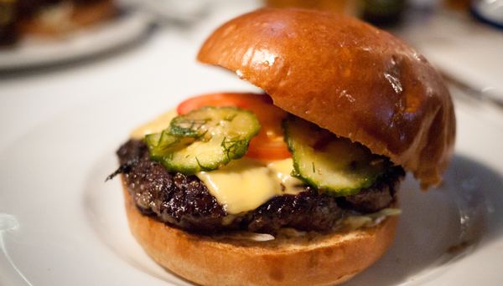
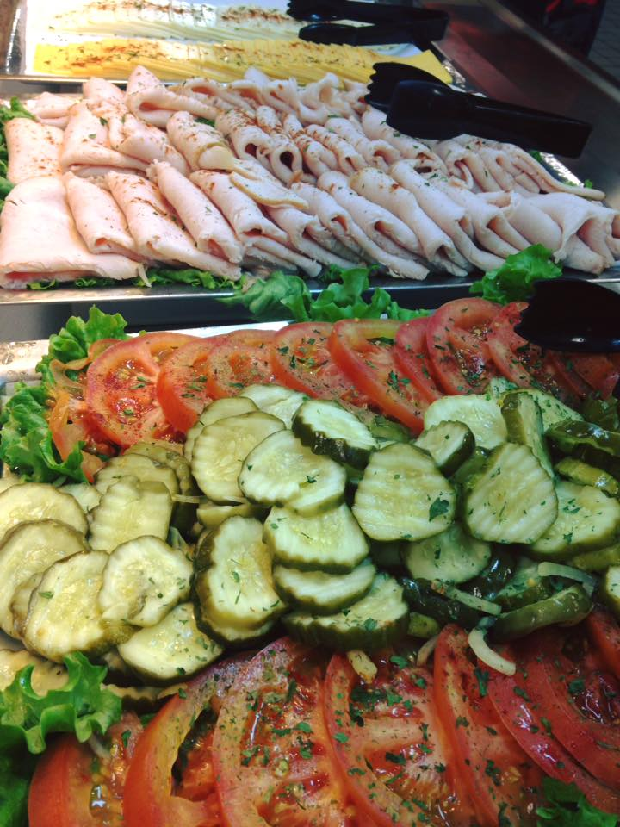
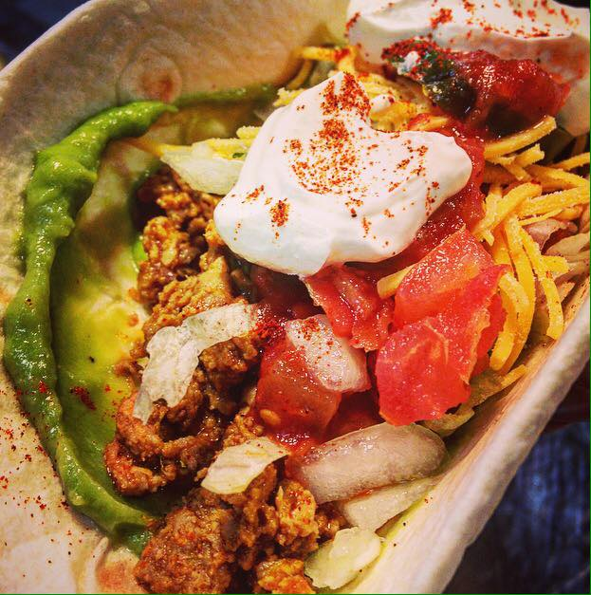
SPECIALTY BUFFET Menu Basic Service
Market Fresh Deli $9.99 | $11.99 Smoked turkey, smoked ham, and Cajun roast beef with assorted cheeses and breads with dressings of green leaf lettuce, sliced tomato, dill pickle slices and condiments. Served with your choice of 2 side items: Italian pasta salad, fruit salad Southern potato salad, or potato chips.
Tex-Mex Extravaganza $10.99 | $12.99 Sizzling beef and chicken served with sautéed onions and peppers. Served with black bean and corn salad, refried beans, Mexican rice, flour tortillas, fresh diced tomatoes, jalapeños, sour cream, salsa, shredded cheese and lettuce, and tortilla chips.
Carolina Coast $10.99 | $12.99 Chicken and sausage pasta jambalaya, red beans and smoked sausage over steamed rice with a tossed green salad, Ranch and Comeback salad dressings and buttery French bread sticks.
Gourmet Burger & Hot Dog $10.99 | $12.99 Grilled thick and juicy burgers, veggie burgers and hot dogs served with assorted cheeses, green leaf lettuce, sliced tomatoes, fresh sliced onions, dill pickle slices and condiments. Served with assorted gourmet rolls and choice of potato salad or potato chips.
Little Italy $12.99 | $14.99 Lasagna Italiano, creamy chicken Alfredo, fresh Caesar salad, steamed broccoli, and buttery garlic bread sticks.
Old Fashioned Bar-B-Q $12.99 | $14.99 Bar-B-Q chicken and pulled pork with baked beans, fruit salad, Southern potato salad, and creamy Cole slaw served with corn bread, gourmet rolls.
All menus include
a dessert,
Sweet & Unsweet Iced Tea
and Iced Water.
Dessert
Cobbler | Apple or Peach
Bread Pudding
Banana Pudding
Chocolate Pie
Chocolate Cake
Lemon Pie
Coconut Cream Pie
Carrot Cake Apple Pie
Cheesecake with Fruit Topping
Additional chef created vegetarian options available upon request

Slide 9
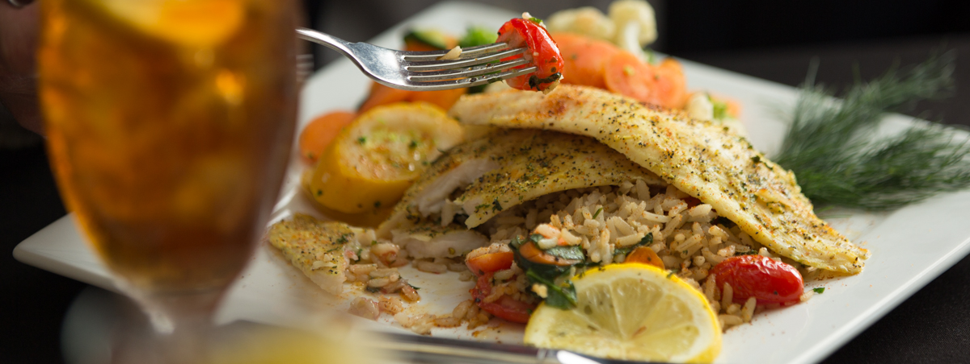
BUFFET Menu Basic Service
Prices are based on groups of 25 – 100. Call for prices below 25 and above 100.
All menus include a Salad, 2 side item choices, rolls, 2 desserts and Sweet & Un-sweet Tea.
A second entrée and additional side items may be included in your menu for an additional charge.
Poultry
Southern Fried Chicken $13| $15 Lemon Herbed Chicken $13| $15
Chicken Parmesan $13| $15 BBQ Baked Chicken $13| $15
Chicken Marsala $13| $15 Roasted Turkey $14| $16
Beef
Roast Beef Au jus $14| $16 Filet of Beef – MKT Price
Prime Rib of Beef $18| $20 Flank Steak $16| $18
Pepper Steak $14| $16 Salisbury Steak $13| $15
Pork
Roasted Pork Loin $14| $16 Honey Glazed Ham $13 |$15
Fish
Southern Style Fried Fish $14 | $16 Herb Baked Tilapia $14| $16
Pasta Dishes
Shrimp & Chicken Jambalaya $13| $15 Italian Lasagna $13 | $15
Red Beans & Rice with Sausage $12|$14 Enchilada Casserole $12 | $14
Shrimp & Grits $14| $16
Vegetarian
Veggie Lasagna , Pasta Primavera or Veggie Plate $11 |$13

Slide 10
BUFFET Side Options
Choice of Salad
Garden Salad
Caesar Salad
Fruit Salad w Poppy Seed Dressing
Sweet & Spicy Romaine Salad
Mixed Field Greens Salad
Cole Slaw
Spinach Salad with Strawberries
Vegetables |  | Starches |  | Desserts
Southern Style Green Beans |  | Black Eyed Peas |  | Cobbler – Apple or Peach
Steamed Mixed Vegetables |  | Roasted Garlic Mashed Potatoes |  | Bread Pudding
Glazed Carrots |  | Steamed White Rice |  | Chocolate Pie
Steamed Broccoli |  | Pasta Alfredo |  | Lemon Pie
Turnip Greens |  | Wild Rice |  | Coconut Cream Pie
Buttered Corn |  | Twice Baked Potato Casserole |  | Carrot Cake
Steamed Asparagus |  | Seasoned Rice Pilaf |  | Cheesecake with Fruit Topping
Steamed Cauliflower |  | Mac & Cheese |  | Banana Pudding
Corn on the Cob |  | Scalloped Potatoes |  | Apple Pie
Steamed Squash |  | Sweet Potatoes |  | Chocolate Cake
Additional chef created vegetarian options available upon request

Slide 11
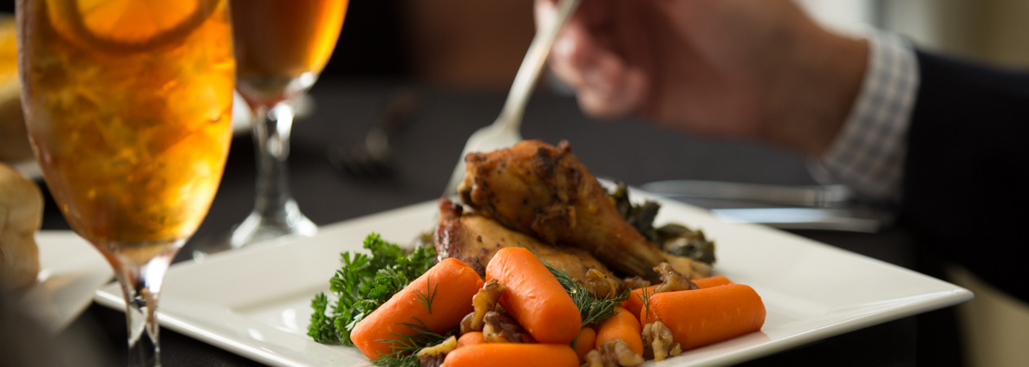
PLATED & SERVED Full Service
All menus include a preset salad, a starch and vegetable choice, rolls, preset dessert and & un-sweet tea.
Events requiring additional service, specialty linens or rental equipment will be priced accordingly.
Flank Steak w Portabella Mushroom Sauce $18| $22
Beef Tenderloin w Balsamic Glaze MKT PRICE
Roasted Pork Tenderloin w Orange Cranberry Salsa $18| $22
Parmesan Crusted Tilapia w Lemon Beurre Blanc $16 | $20
Pecan Chicken w Sour Cream Dijon Sauce $16 | $20
Zesty Chicken w Corn & Black Bean Salsa $16 | $20
Blackened or Pecan Crusted Cod $16 | $20
Broiled Salmon w Pineapple Chutney MKT PRICE
Sautéed Shrimp in a Lemon Garlic Butter Sauce MKT PRICE
Portobella Steak with a Balsamic Glaze $16 | $20
Veggie Trio $14 | $18
Choice of Salad
Garden Salad
Caesar Salad
Fruit Salad w Poppy Seed Dressing
Sweet & Spicy Romaine Salad
Mixed Field Greens Salad
Spinach Salad with Strawberries
Vegetables |  | Starches |  | Desserts
Sautéed Whole Green Beans |  | Roasted Red Potatoes |  | Cobbler – Apple or Peach
Steamed Mixed Vegetables |  | Roasted Garlic Mashed Potatoes |  | Bread Pudding Banana Pudding
Glazed Baby Carrots |  | Steamed White Rice |  | Chocolate Pie Chocolate Cake
Broccoli w Hollandaise |  | Roasted Sweet Potatoes |  | Red Velvet Cake
Sugar Snap Peas |  | Wild Rice Rice Pilaf |  | Coconut Cream Pie
Braised Cabbage |  | Twice Baked Potato Casserole |  | Carrot Cake Apple Pie
Steamed Asparagus |  | Lemon Couscous Basil Orzo |  | Cheesecake with Fruit Topping

Slide 12
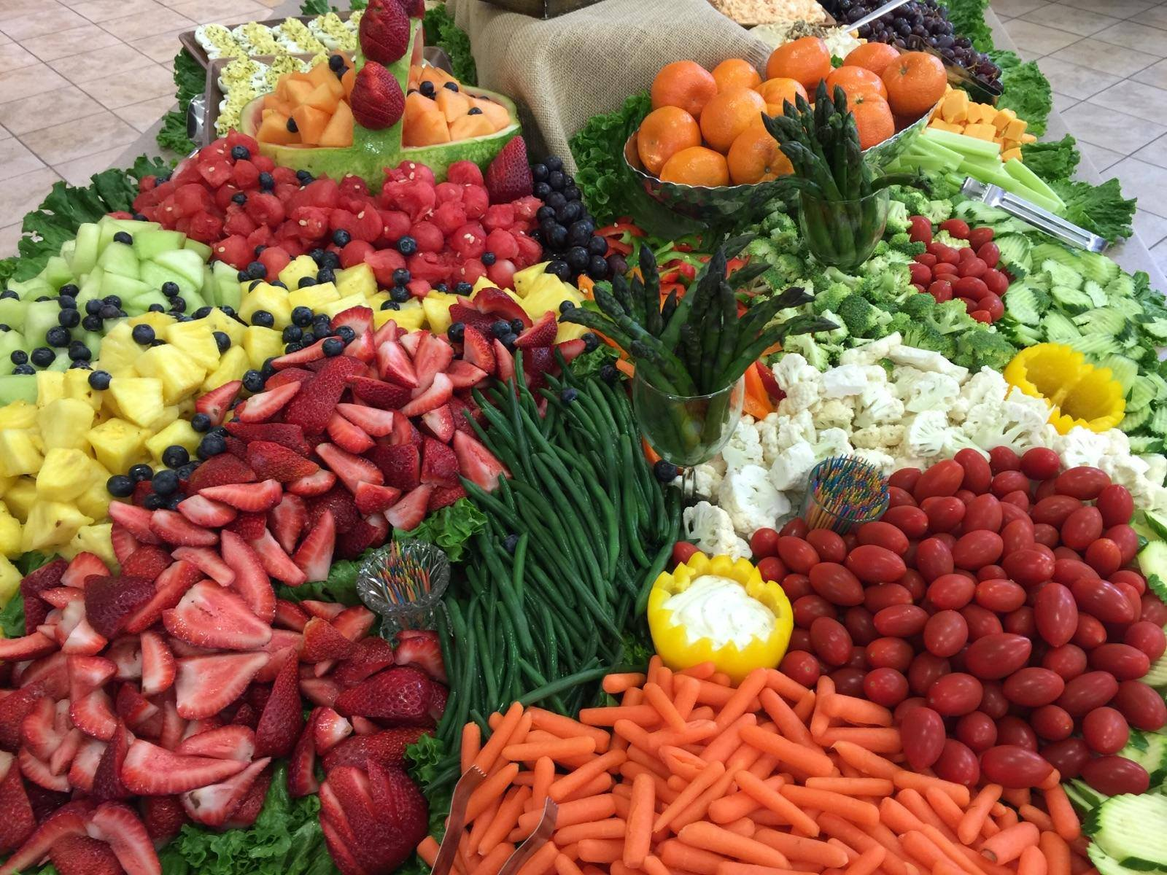
RECEPTION MENU Ideas Appetizers & Hors d’ oeuvres
Cold
Selections
Sandwiches & Toast Points
serves 25
Smoked Salmon Canapes $55| $60 with a dill spread on rye toast points
Club Sandwich Triangles $55| $60
Mini Croissant Sandwiches $40 | $45
Open Faced Sandwiches $40 |$45 Cucumber or Tomato with garlic aioli
Sliders $40 | $45 Roast Beef, Turkey & Pork Tenderloin with a choice of sauces and a relish tray
Mini Muffulettas $68| $75
Chicken Salad Pastry Cups $45| $50
Tomato & Bacon Bites $40 | $45 Wheat toast point w bacon/onion spread & tomato slice
Celery Sticks Stuffed
with Pimento Cheese $30 | 35
Platters - serves 25
Garden Vegetable Tray $40| $45 w/Buttermilk Ranch Dressing, fresh broccoli, cherry tomatoes, baby carrots and celery
Fresh Fruit Tray $45| $50
grapes, strawberries and more seasonal fruit with yogurt dip
Fruit and Cheese Tray $65| $70
Seasonal fruit with pepper jack, Swiss, and cheddar cheeses
Strawberries and Cream $55| $60
Fresh berries and Devonshire Cream
Gourmet Cheese Tray $68 | $75
Gouda, Boursin, Cheddar and Fontina with gourmet crackers
Antipasti Tray $68| $75
olives, marinated vegetables and cheeses served with gourmet crackers.
Dips & Spreads – Serves 25
Hummus & Pita Chips $45 | $50
Classic French Onion Dip w Chips $39| $35
Seven Layer Mexican dip w Chips $40 |$45
Chips and Salsa $25| $30
Corn Dip with Chips $30 | $35
Pickup Items -Per 50
Deviled Eggs $50| $55
Steamed Shrimp w/Cocktail Sauce
$68 | $75

Slide 13
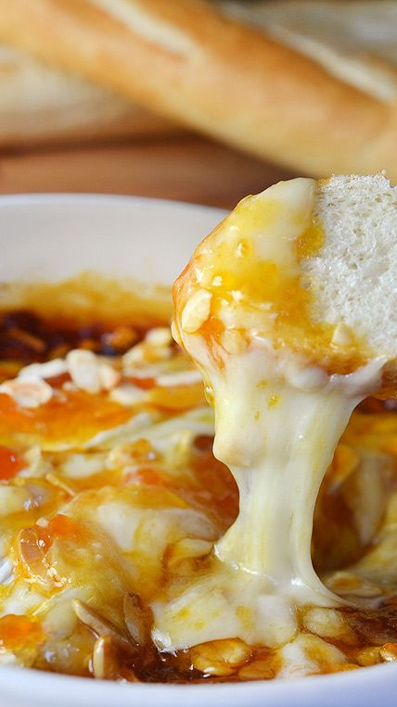
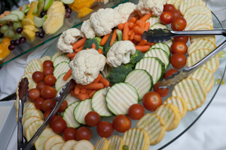
Hot Selections
Pick Up Items – Per 40
Chicken Tenders $50|$55 with 2 sauces
Chicken Drumettes $50| $55 tossed in your choice of sauce and served with Blue
Mini Egg Rolls $45| $50 w/Sweet & Sour Sauce
Stuffed Mushroom Caps $60|$65
Crab or Sausage
Catfish Strips $50| $55 w cocktail or rémoulade
Assorted Mini Quiche $45|$50
Vegetable Spring Rolls $68 | $75 w/Sweet & Sour
BBQ or Marinara Meatballs $25| $30
Sausage Cheese Balls $35 |$40
Fried Ravioli $60 | $65 with Marinara
Mini Crab Cakes $68 | $75 with Remoulade
BBQ Smokies $25 | $30
BBQ Sliders $35| $40
Chicken Satay $60| $65 with Peanut Sauce
Grilled Andouille Sausage Bites $40| $35 with Creole Mustard
Grilled Chicken Kabobs $65| $70
Hot Dips – Serves 25
Rotel Dip with Chips $35| $40
Spinach & Artichoke Dip with Chips $35| $40
Buffalo Chicken Dip with Chips $45| $50
Hot Seafood Dip with Crackers $60| $65
Captain Rodney’s Dip with Crackers $35| $40
Baked Brie with Toast Points $55| $60
Hot Bacon & Onion Dip $35| 40
Chef Attended Stations
Priced according to needs and counts
Carving Station
Pasta Station
Mashed Potato Bar
Grits Station

Slide 14
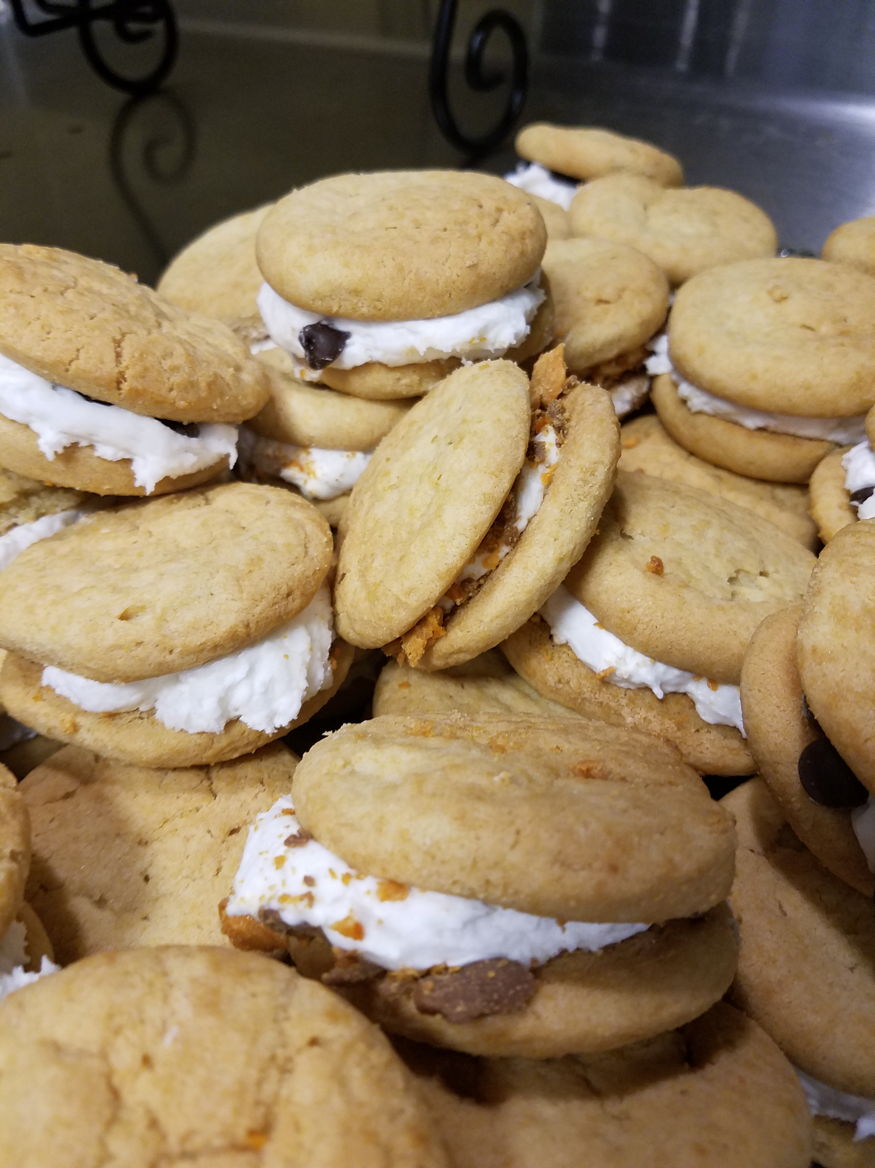
SOMETHING SWEET
Dessert Options
By the Dozen
Fresh Baked Cookies $12| $15
Double Chocolate Brownies $18| $20
Dessert Bars $20| $24
Chocolate Dipped Strawberries $20|$24
Whoopie Pies $35 | $40
Cookie Sandwiches $35| $40
Cheesecake Bites $20| $25
By the Pan – Serves 12
Bread Pudding $30| $35
Apple Cobbler $30| $35
Pecan Cobbler $38| $42
Peach Cobbler $30 | $35
Banana Pudding $28 |$32
Sheet Cakes – Call for price
Whole Pies – Call for price

Slide 15
SERVICE LEVEL & Staffing Options
Qualified staff is a key requirement for hosting an event with exceptional service. It is also a very large percentage in the cost of a catered event. The number and quality of staff is of the utmost importance to ensure that your event is set up properly, your guests are welcomed to the event, glasses are filled, food is served in a timely manner with hospitality and your event is cleaned up. This allows for you and your guests to focus on enjoying the event.
We offer three levels of service to meet your needs. DROP OFF Drop off service includes buffet linens for the food table and disposable service ware for your event. Orders will be delivered 30 minutes prior to the event times indicated on your Catering Event Order. No service staff included. Client is responsible for all table service and cleanup.
BASIC BUFFET SERVICE Recommended for casual full breakfasts receptions, lunches and dinner, this service includes upscale disposable and buffet table lines. Guest table linen will be an additional charge. Orders will be delivered and setup 30 minutes prior to and cleaned up 30 minutes follow the event times indicated on your Catering Event Order. No service staff included. Client is responsible for all table service. Events over 50 people or involving refilling the serving line must be attended by service staff. Please see staffing guidelines below.
FULL-SERVICE TABLE SERVICE Waited table service is available for more formal sit-down meals. Service includes complete setup and cleanup of your event. China, glassware, silver, basic guest table linens and cloth napkins are included. One server per 25 guests is included.
Upgrade to biodegradable disposables $1.50 per person
China service on buffet includes china service ware set up, house linen for guest seating tables and servers - $3.99 per person
China service on reception includes china service ware set up and servers - $2.99 per person
Beverage service includes appropriate glass and stemware - $1.50 per person
Full-service drop-off china ware (only available for 25 people or less) - $2.99 per person
The required number of staff for full -service events:
Disposable buffet or reception - one server per 50 guests
China buffet service - one server per 30 guests
China plated service - one server per 20 guests
China reception - one server per 30 guests
Bartenders & Beverage Service – 2 per 50 guests
Chefs and back of the house staff will vary with each event depending on group size and menu.
All service staff are charged at $18.00 per hour with a minimum of 3 hours.
Prices are based on the duration of the event plus one-half hour prior and one-half hour after to cover setup and tear down. We are happy to extend the service time for an additional charge.
For delivered orders, the food will be delivered to your event location, set up, and cleaned up after the event. It will not be attended during the event unless previous arrangements have been made for service staff. Additional charges will apply.
Events over 50 people or involving refilling the serving line must be attended at the Catering Services predetermined staffing levels and service staff charges will be added to the final bill.
Unscheduled client requests for refills, additional food, etc. are available for an additional charge.

Slide 16
Notes:

Slide 17
Catering Idea Guide

